Slide 1
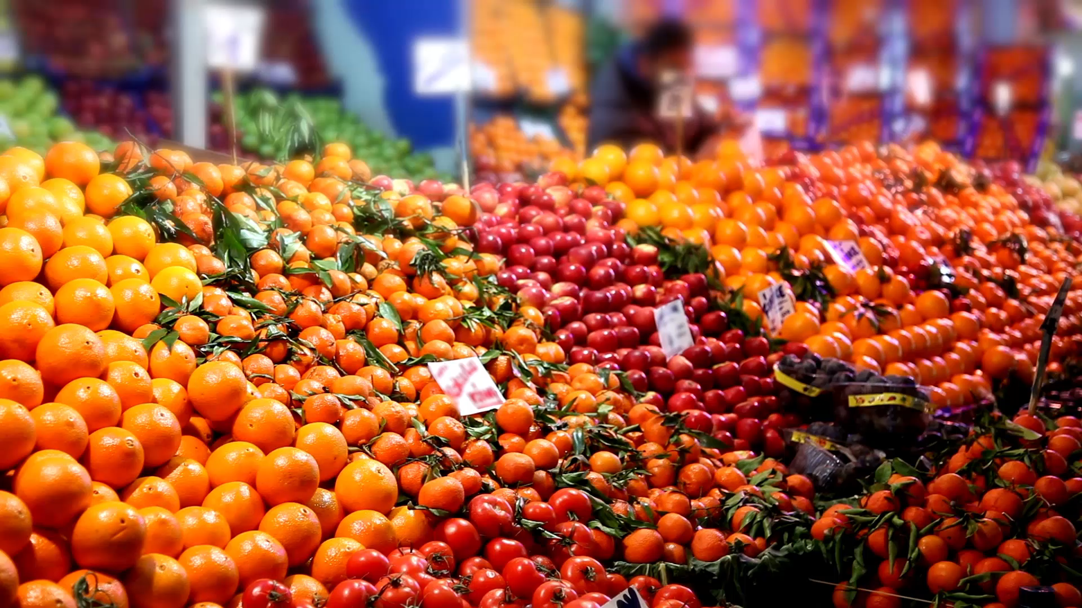
Supermarket Analysis
SHUBHKUMAR PATEL
(3077432)

Slide 2

Contents
About Data
Goals/ Business Questions
Tableau Analysis
Model
Time Series Forecasting
Conclusion

Slide 3
About Data
Data : Supermarket Data with 21 attributes and 9995 rows.
Data has record of Different categories sales and their profit according to the region with period duration – (2014 to 2017)
DATASET SOURCE: https://www.kaggle.com/datasets/vivek468/superstore-dataset-final

Slide 4

Goals/ Business Questions
Where is Superstore Profitable?
What is common shipping mode preferred?
What segmentation gives more profit to store?
Which state(city) specifically should store invest more?
Forecasting future profit estimates for different categories

Slide 5

ANALYSIS BY TABLEAU

Slide 6
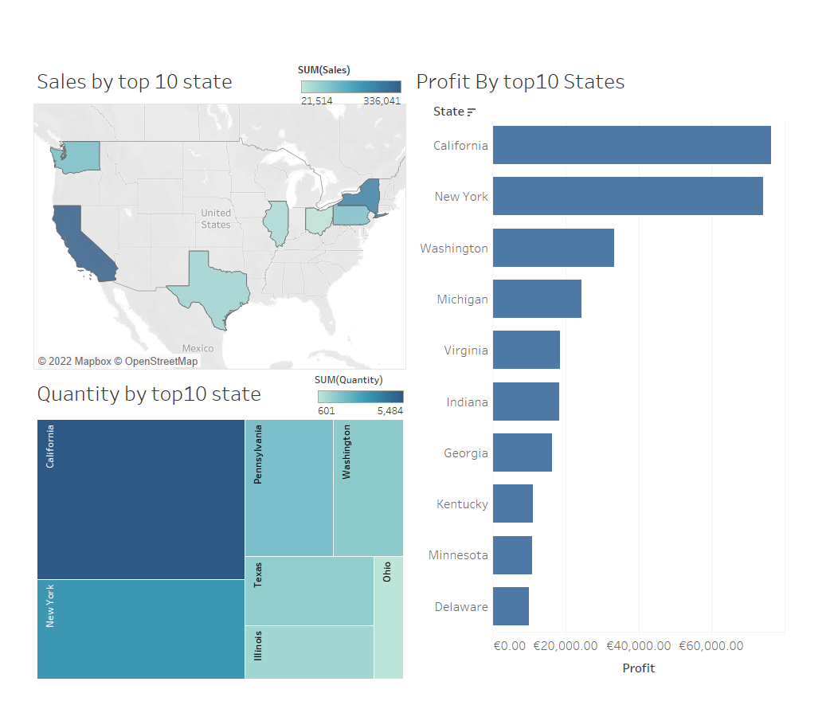
Where is Superstore Profitable?

Slide 7
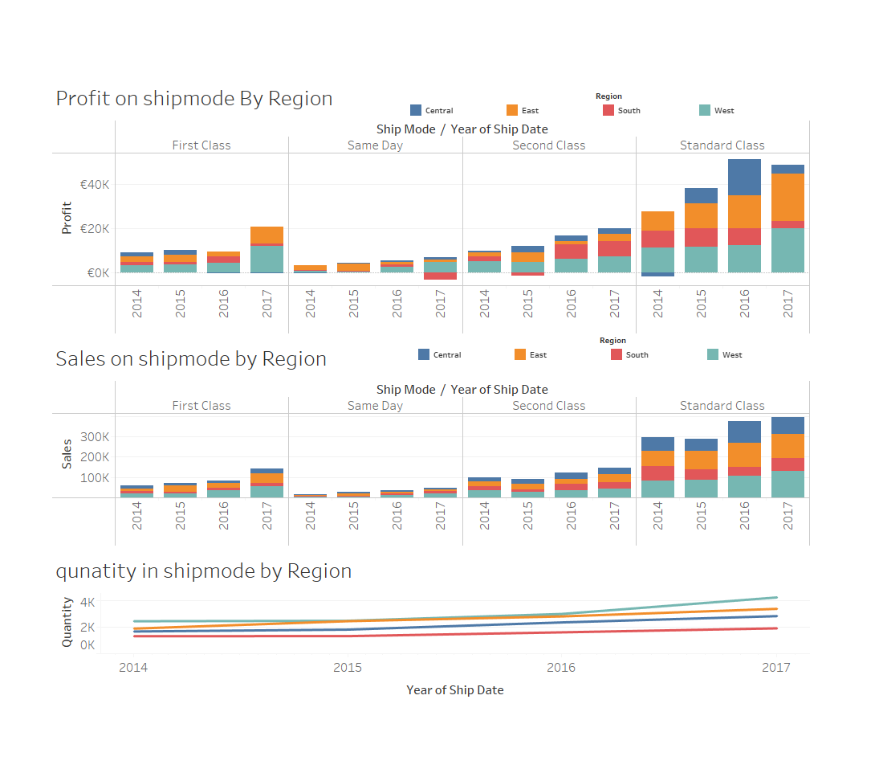
The most common shipping mode preferred is Standard Class as the price for shipping is low and most of the times is takes the same time as second class and sometimes it is also delivered on the same day.

Slide 8
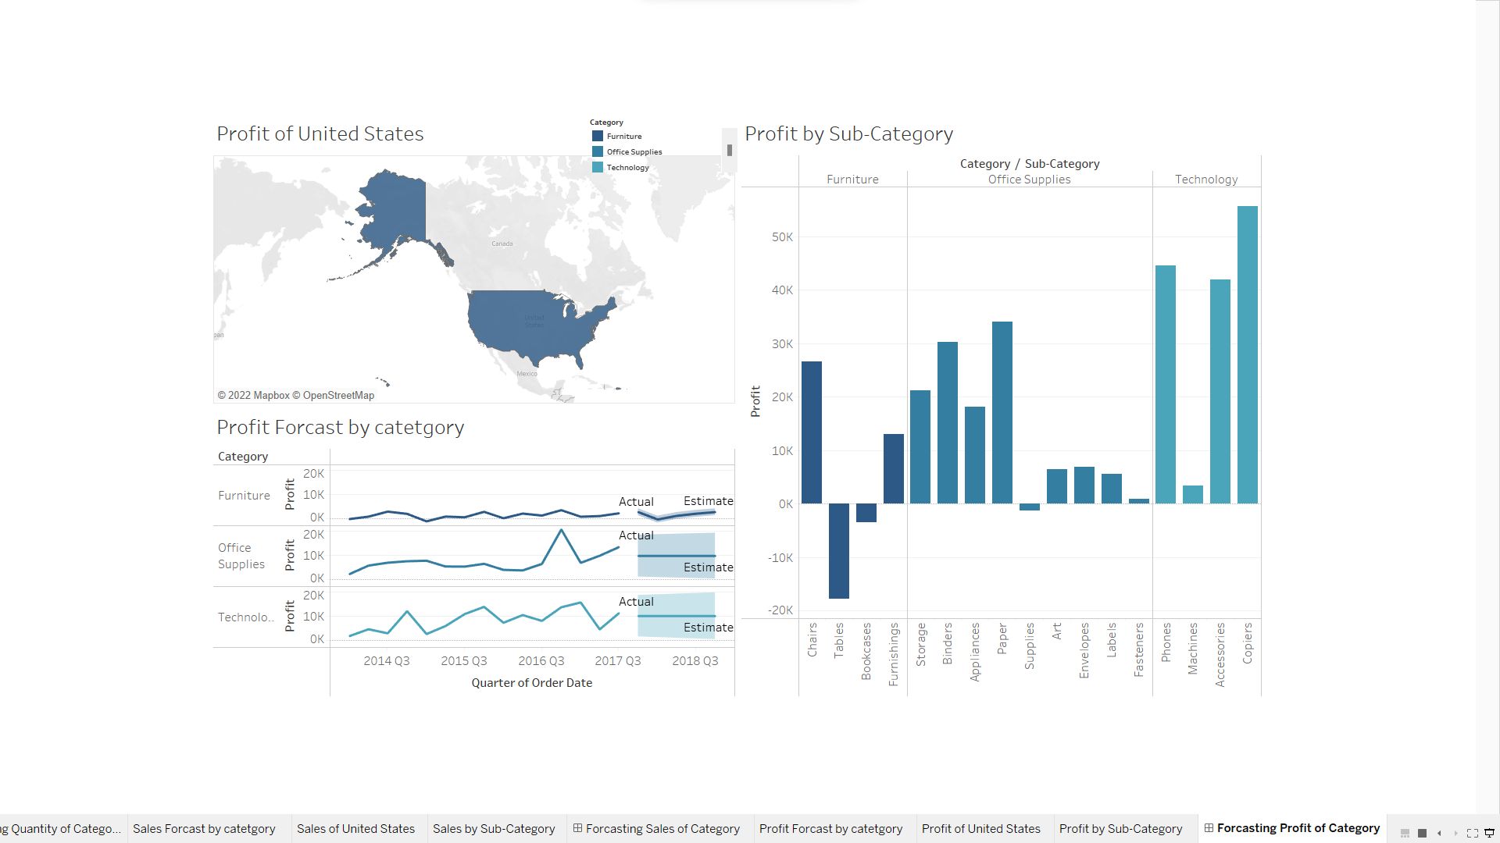
The maximum profit performance is observed in the technology segment towards the east part of the United States. This is because of increase in the number of universities and new emerging industries.

Slide 9
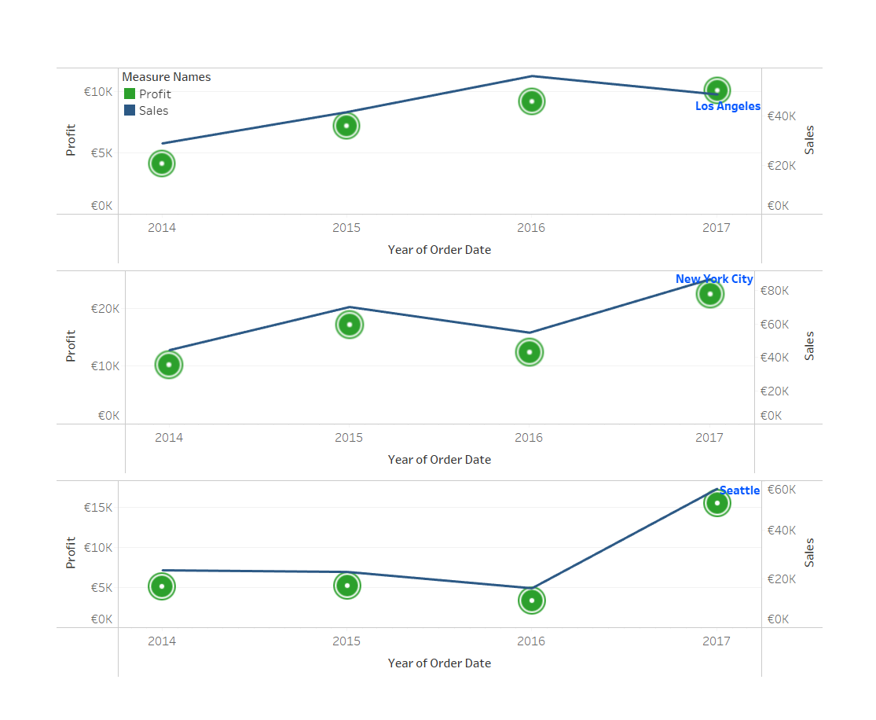
New York State is the highest in sales among all other states. So investing more in this state would increase overall sales.

Slide 10
ARIMA MODEL
ARIMA is a forecasting technique that projects the future values of a series based entirely on its own inertia
Its main application is in the area of short-term forecasting requiring at least 40 historical data points.
The seasonal ARIMA model incorporates both non-seasonal and seasonal factors in a multiplicative model.
One shorthand notation for the model is ARIMA(p,d,q) x (P,D,Q)S
With p = non-seasonal AR order, d = non-seasonal differencing, q = non-seasonal MA order, P = seasonal AR order, D = seasonal differencing, Q = seasonal MA order, and S = time span of repeating seasonal pattern.

Slide 11
TIME SERIES FORECASTING

Slide 12
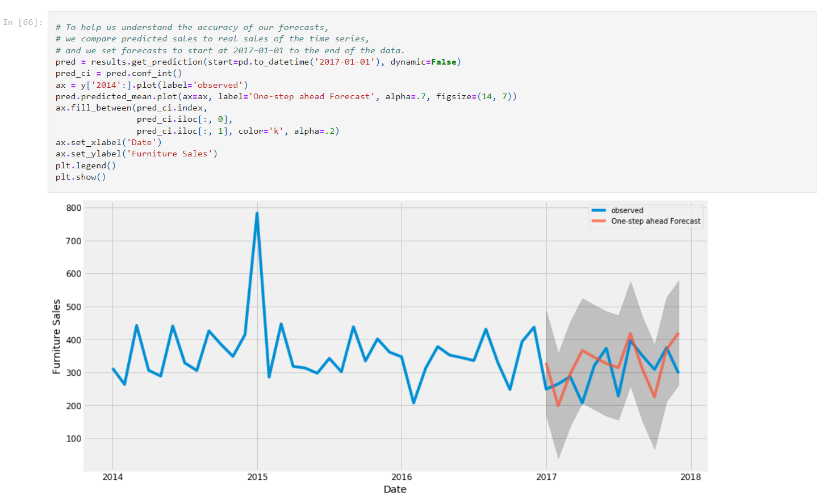
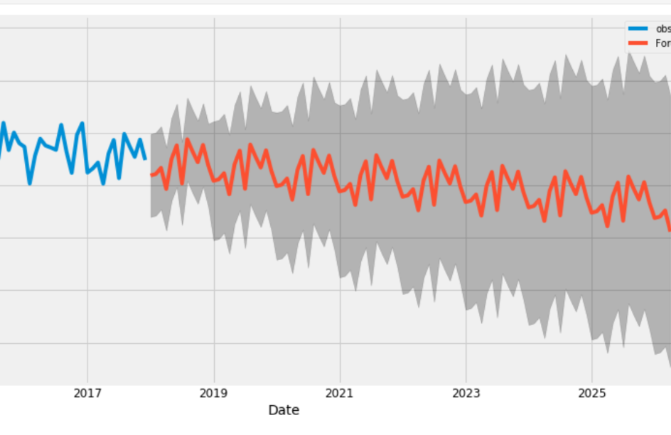
Forecast of Furniture Sales from Jan 2018

Slide 13
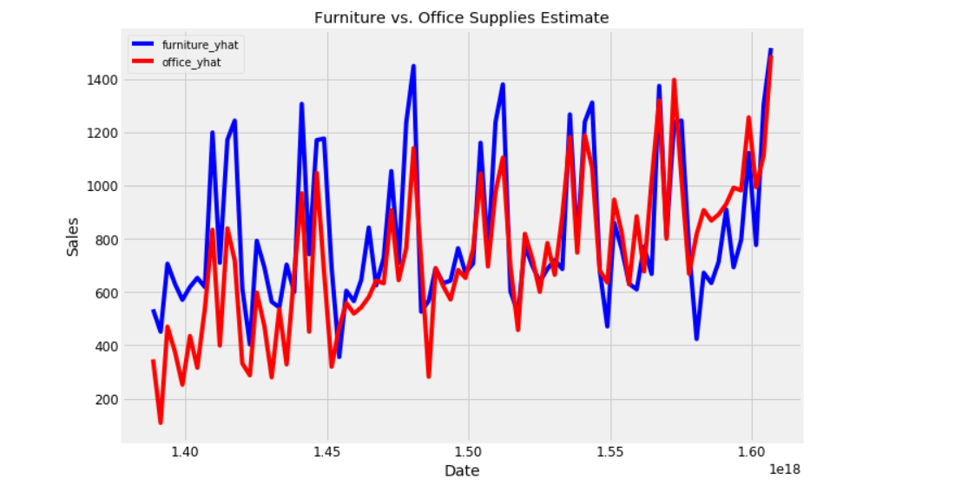
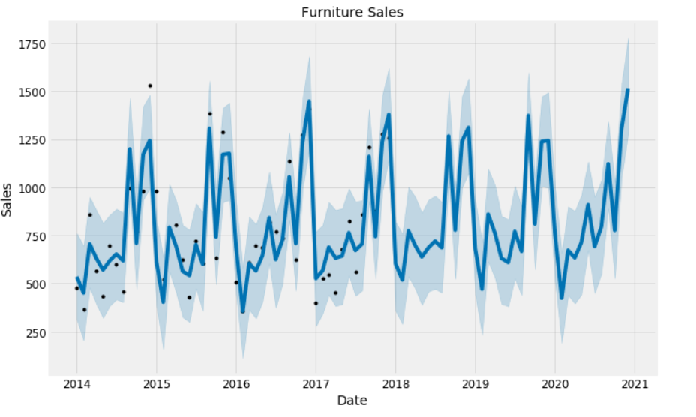
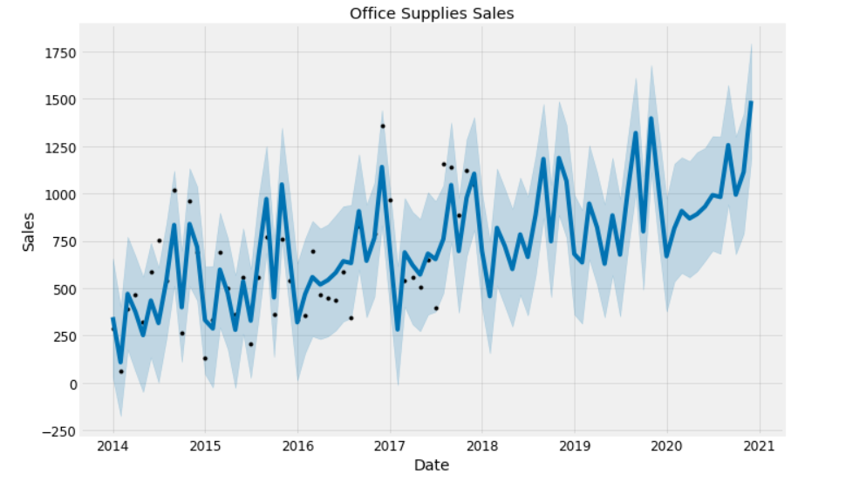
Forecast of Furniture VS Office Supplies Sales from Jan 2018

Slide 14
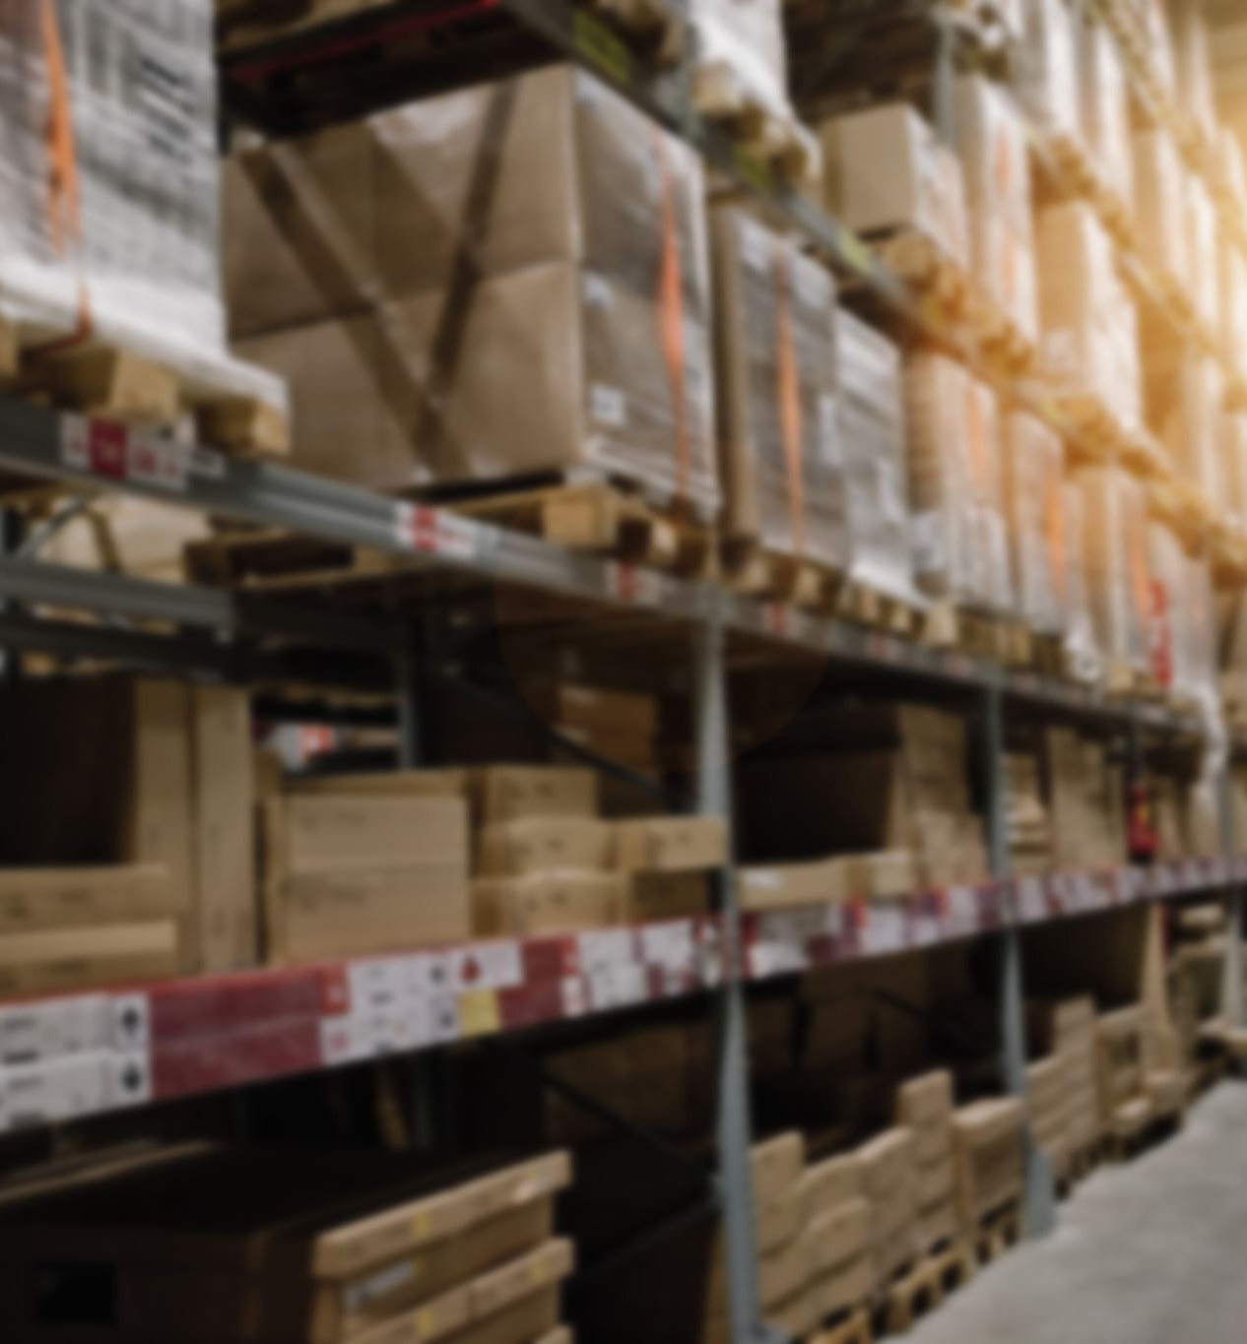
Conclusion
The category Technology from 3 main categories in the supermarket has the highest sales & profit.
The Store should invest more in New York State as it is the highest profit state.
Furniture sales From 2018 follow the similar trend as the previous year.
Furniture VS Office Supplies Sales from 2018 Where Office Supplies show a downward trend but following the same seasonality.
The overall sales is the most Unprofitable in the state of Texas.

